Slide 1
BINARY NUMBERS
Ganesh Kumar Ranjan
Faculty, MJMC,
MMHA&PU

Slide 2
The first modern computer ‘ to use binary, on and off switches to make calculations’ was invented in 1939 by
John Atanasoff(Academic)
& Clifford Berry(Graduate Student)
Iowa state University
Binary numbers
O- off
1- on

Slide 3
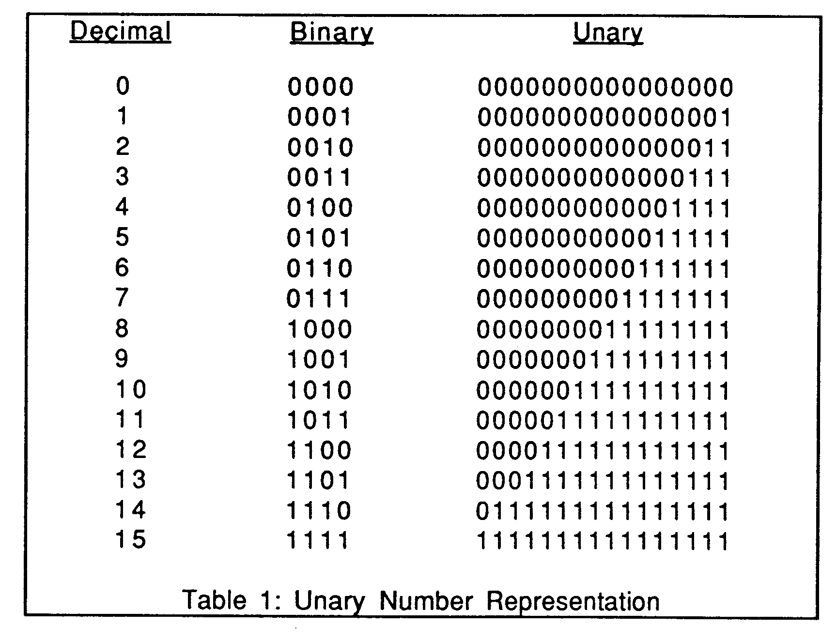

Slide 4
Conversion
Binary to decimal
1101
1×2⁰ =1
0×2¹ =0
1×2² =4
1×2³ =8
= 1+0+4+8
=13
11.11
1×2⁰ =1
1×2¹ =2
1×2⁻¹ =1/2= 0.5
1×2⁻² =1/4= 0.25
= 1+2+0.5+0.25
=3.75

Slide 5
Binary Addition
0+0=0
0+1=1
1+0=1
1+1=10
If we have a result greater than 1 , we carry a ‘1’ to next digit
Ex
0010
+1100
=1110
1100
+1110
=011010

Slide 6
For letter symbols
Coding system
ASCII- American Standard Code for Information Interchange
EBCDIC- Extended Binary Coded Decimal Interchange Code
Letter | ASCII | EBCDIC
A | 01000001 | 11000001
B | 01000010 | 11000010
C | 01000011 | 11000011

